Slide 1

Emotion
Recognition

Slide 2
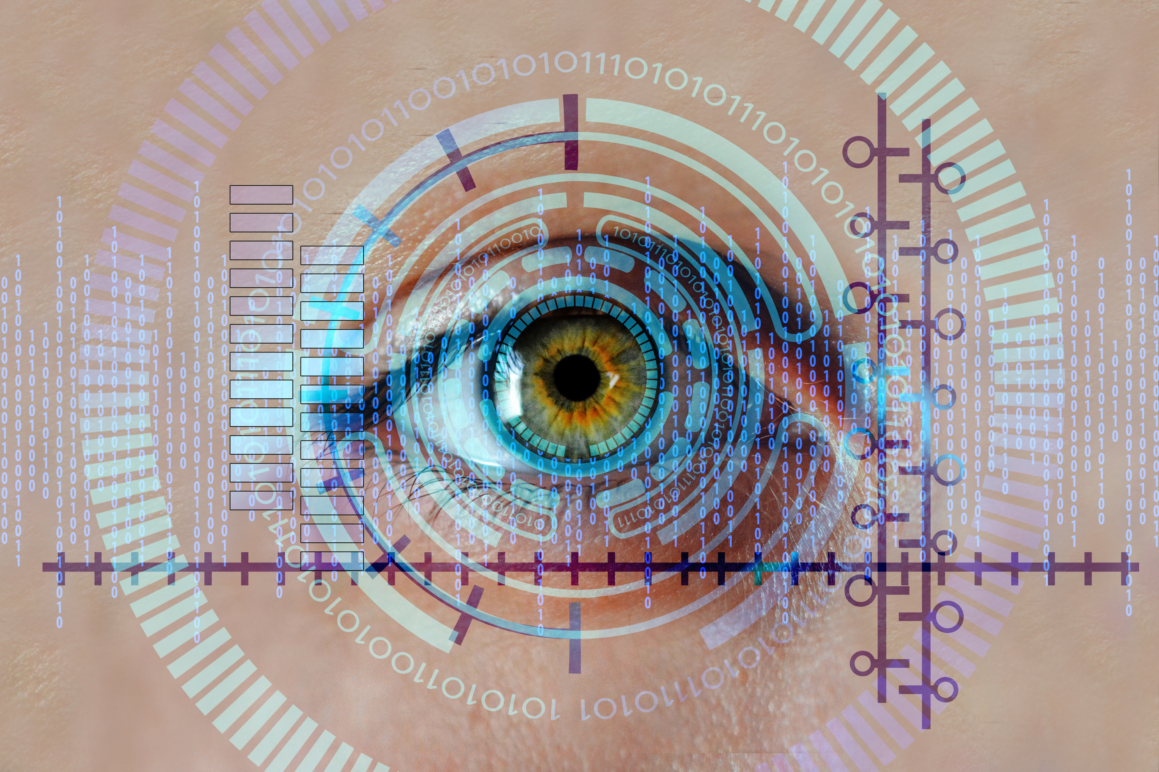

What Is Emotion Recognition?
Emotion recognition is the process of automatically identifying human emotions such as happy, sad, angry, fear, surprise, disgust, and neutral using facial expressions, voice, or other signals.”

Slide 3

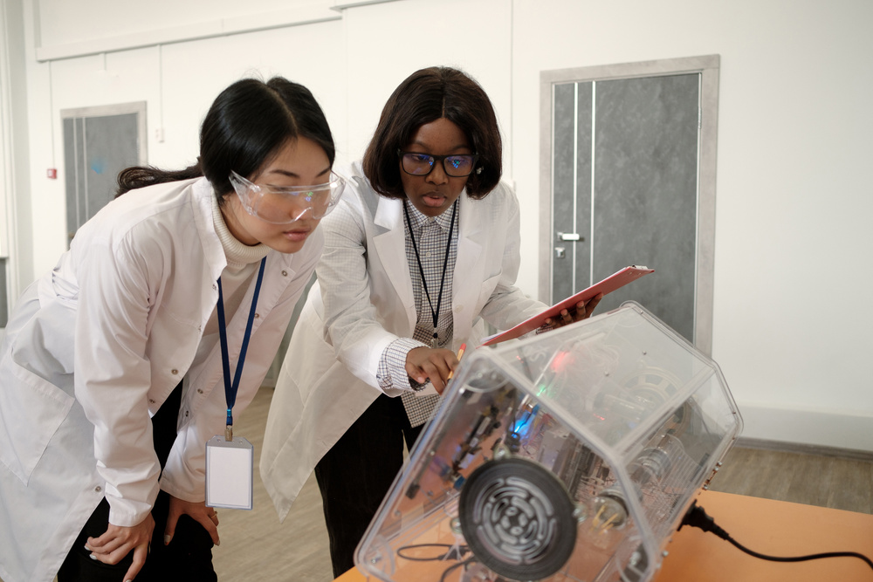
From Detection to Identification
How Emotion Recognition Works
Emotion recognition works by capturing facial images using OpenCV, then preprocessing and analyzing them with DeepFace, which classifies the emotions into categories like happy, sad, angry, fear, surprise, disgust, and neutral.

Slide 4

Main Applications
Where It’s Being Used Today
Healthcare
Detecting stress, depression, and patient emotions.
Customer Service
Enhancing chatbots and call centers with emotion-aware responses.
Automotive
Monitoring drivers for drowsiness or anger to improve safety.

Slide 5

Key Benefits
Why Organizations Are Adopting It
Improved Human-Computer Interaction
Enhanced Safety & Well-being
Better User Experience
Systems can respond based on user emotions.
Detects stress, fatigue, or negative emotions early.
Provides personalized and engaging services.

Slide 6
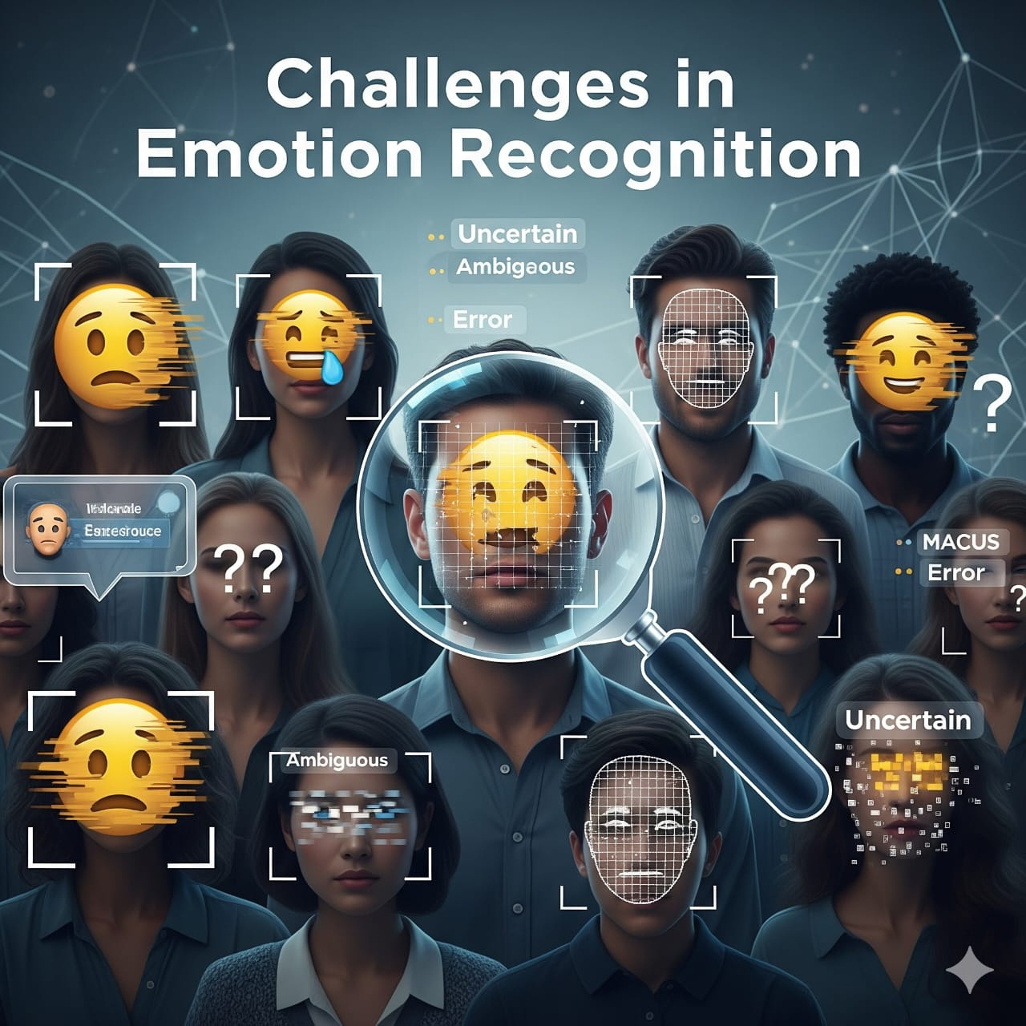
Challenges in Emotion Recognition
1.Variations in lighting, pose, and facial expressions
2.Difficulty handling mixed or subtle emotions
3.Privacy and ethical concerns
Real-time processing complexity

Slide 7
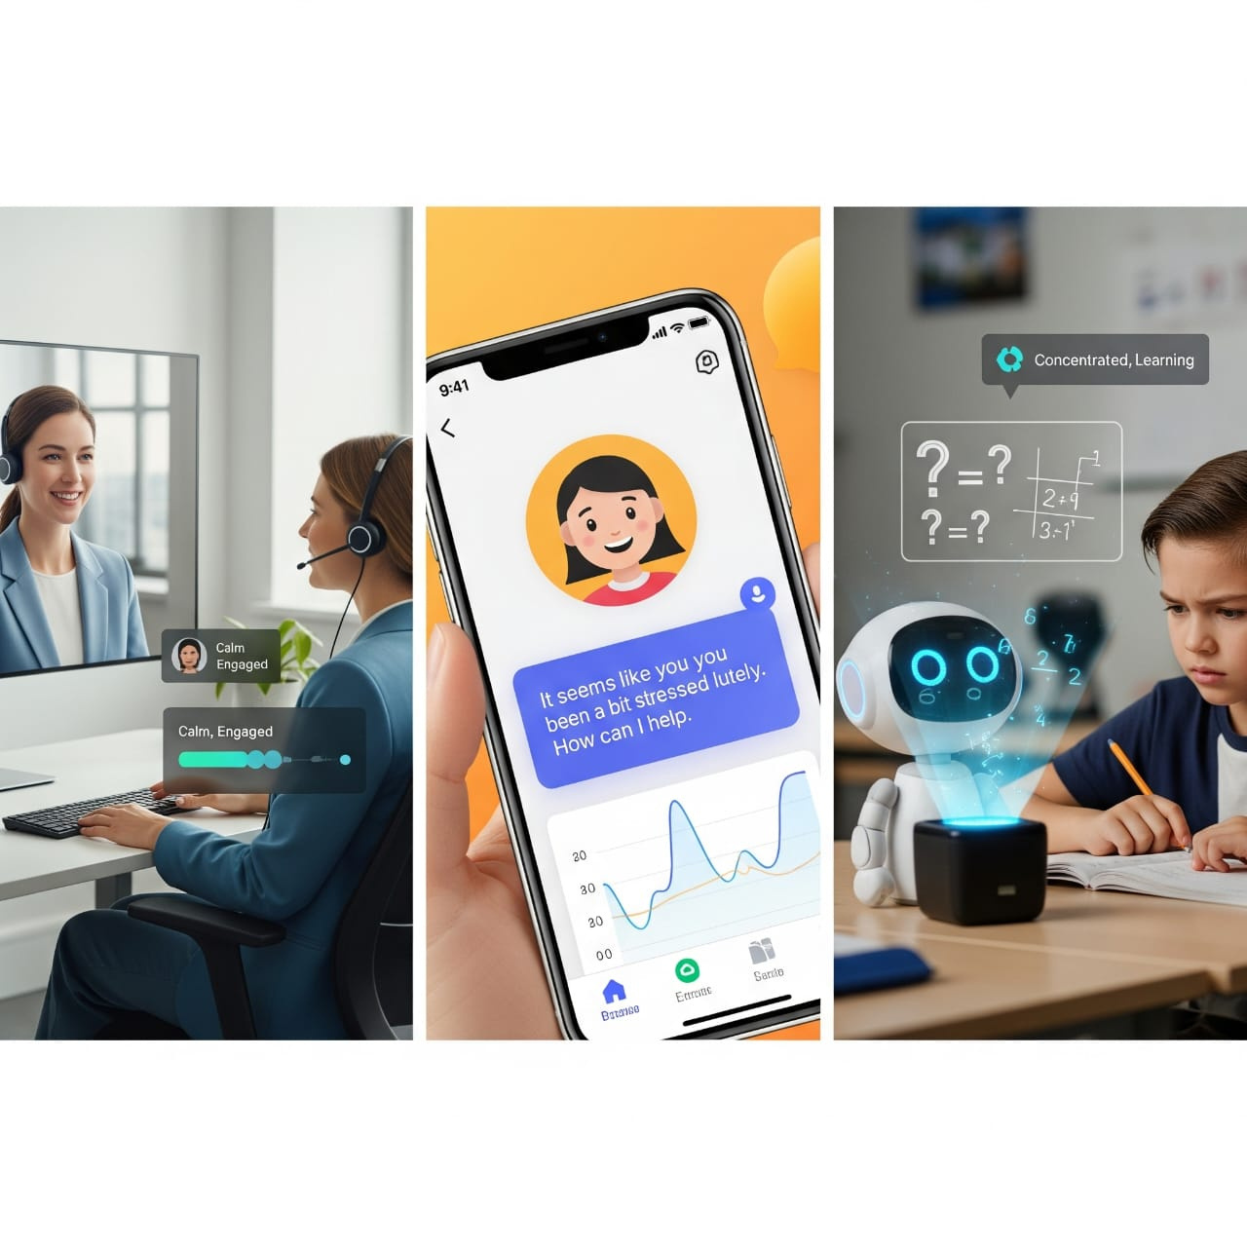
Future Scope
Integration with AI-powered assistants & robots
Use in mental health monitoring apps
Emotion-based personalized learning & entertainment
Combining multiple signals (face + voice + physiological) for accuracy

Slide 8
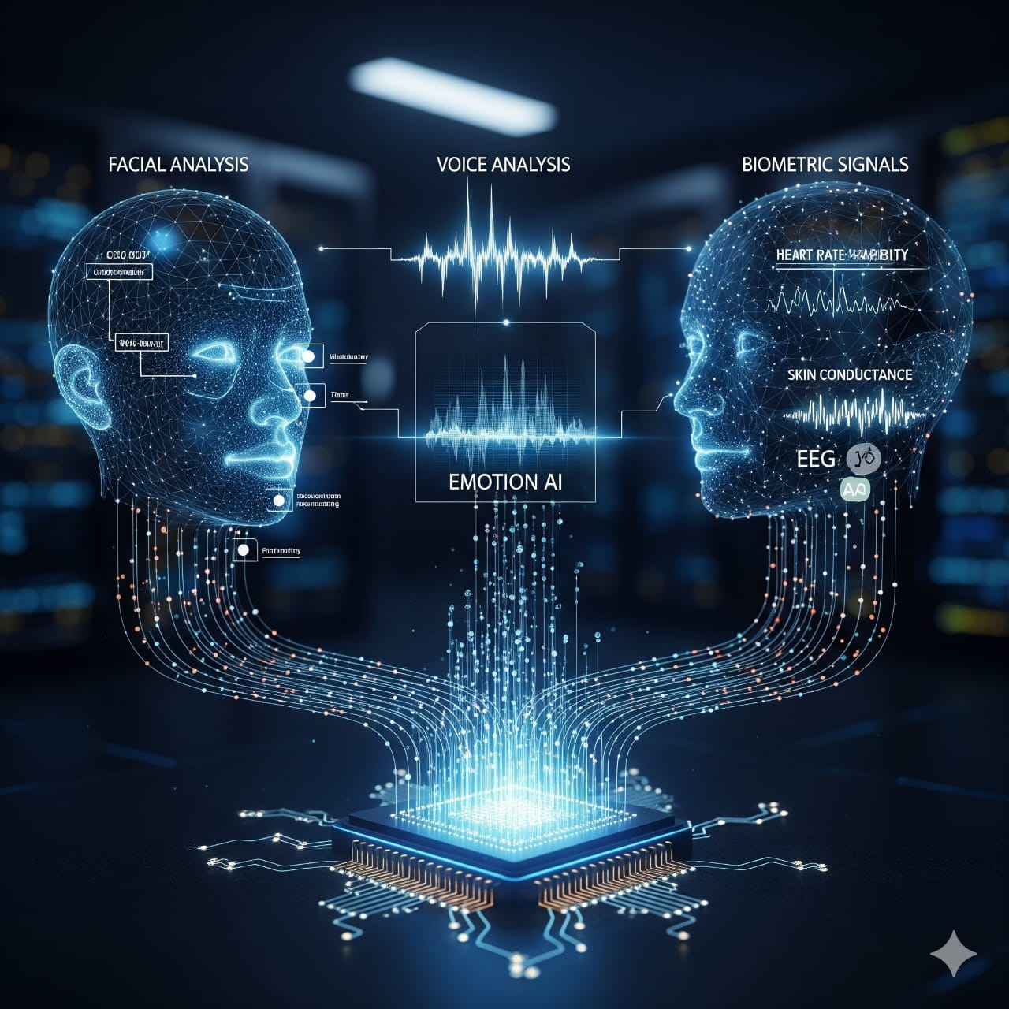
Looking Ahead
Advancing towards real-time emotion-aware systems
Combining facial, voice, and biometric signals for higher accuracy
Applications in mental health support, adaptive learning, and smart vehicles
Ethical use ensuring privacy and responsible AI

Slide 9

Facial Recognition in Real Life
OpenCV captures the driver’s face in real-time.
DeepFace analyzes emotions such as drowsy, angry, or distracted.
If drowsiness/anger is detected → system alerts the driver.
Helps prevent accidents and improves road safety.
Case Scenario

Slide 10
Thank You
Get In Touch

